Slide 1

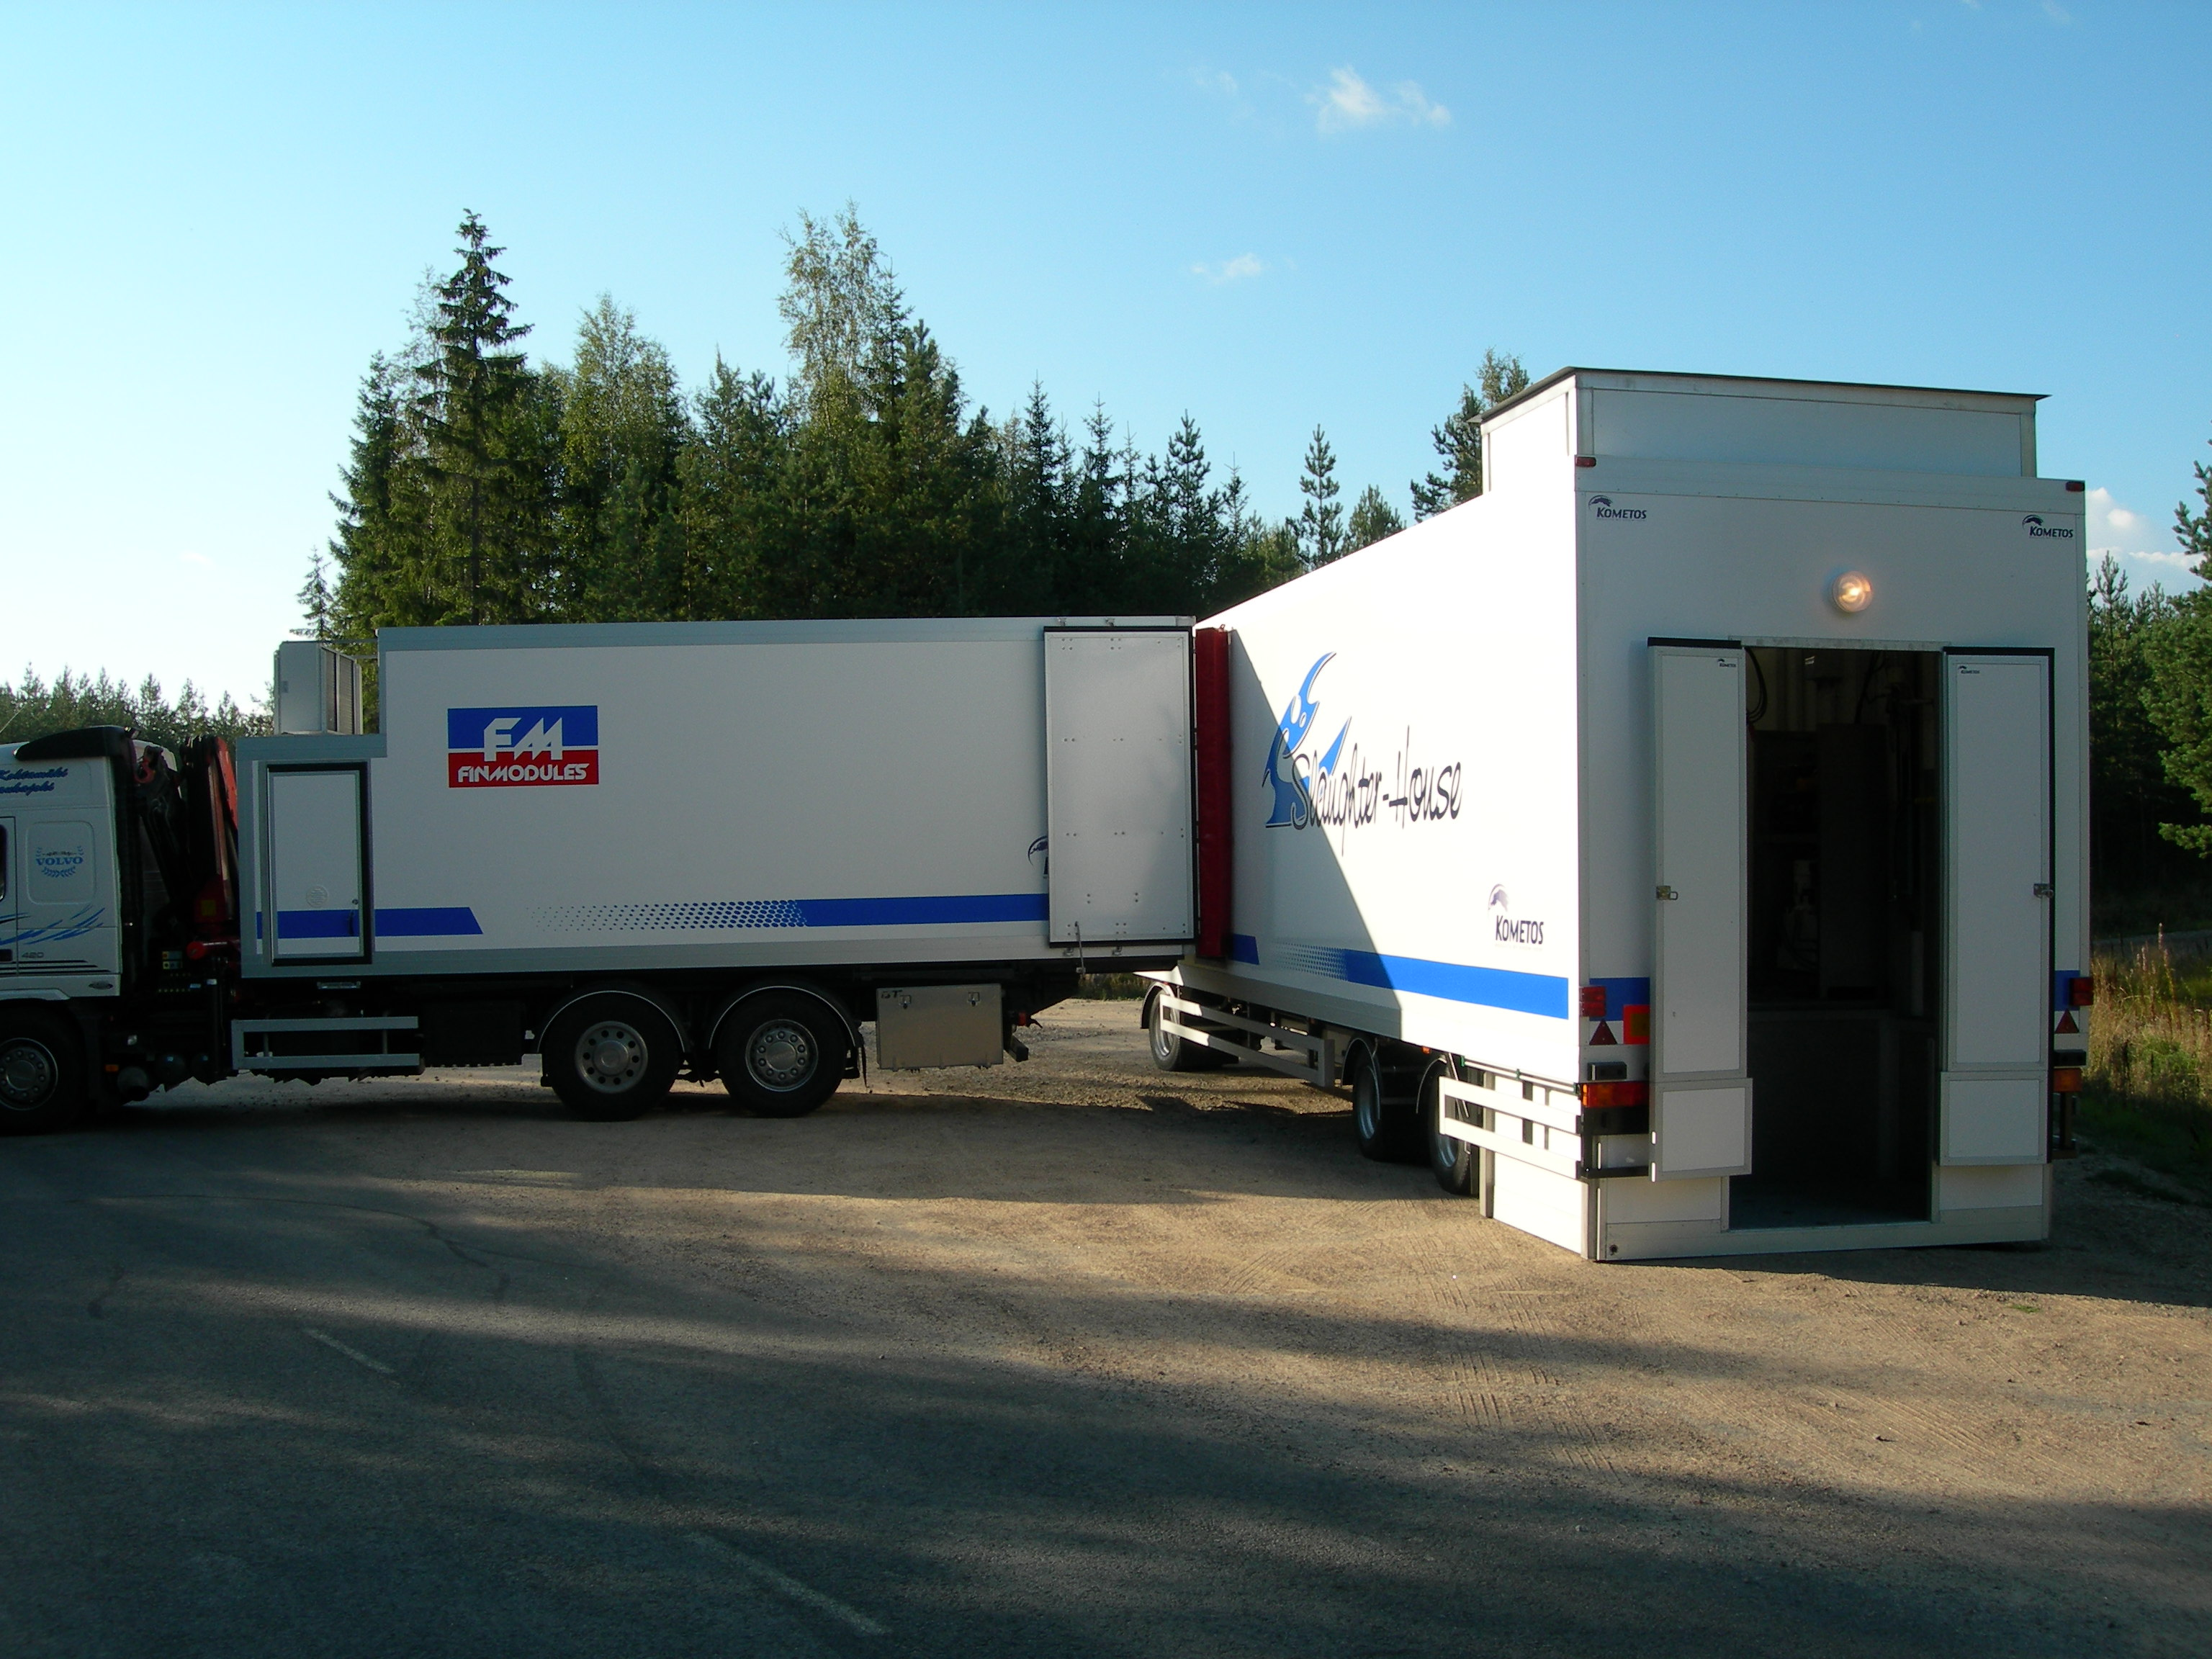
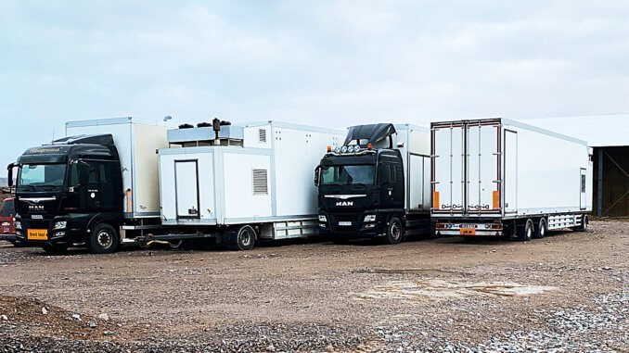

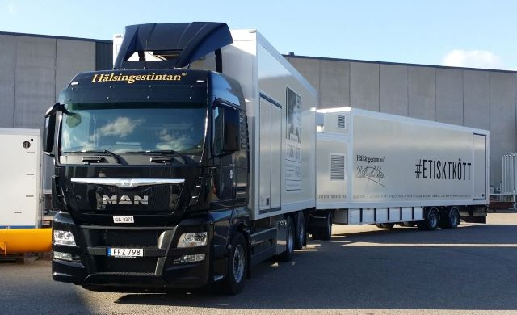
FINNISH INNOVATION: MOBILE SLAUGHTER UNITS www.kometos.com

Slide 2
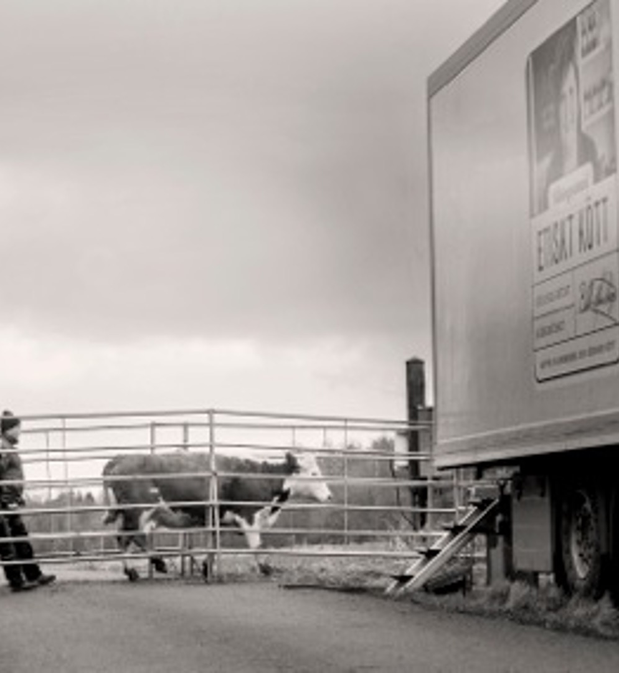
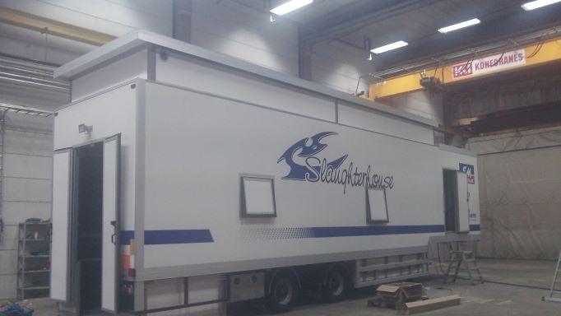
Company
KOMETOS is the world leader in modular and mobile livestock slaughter units, thawing systems and modular fish, seafood and food processing facilities.
A Private company based in Kauhajoki in Western Finland
Export focused with 30 years of export sales into Nordic States, Russia, Europe, Eastern Europe, Asia, Australian and North American markets.
All units and equipment are built to EC standards 852/853/854 of 2004 compliant with current EU food and meat hygiene regulations.
Kometos has technical partner’s all over world to quarantee service to Kometos products.
https://www.kometos.com/home

Slide 3
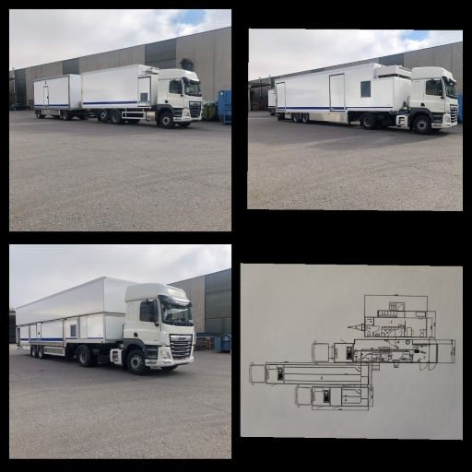
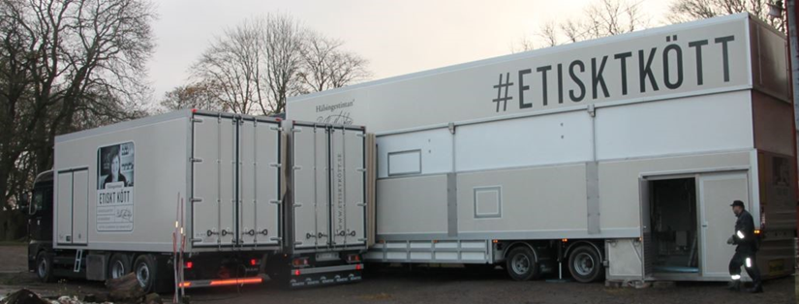
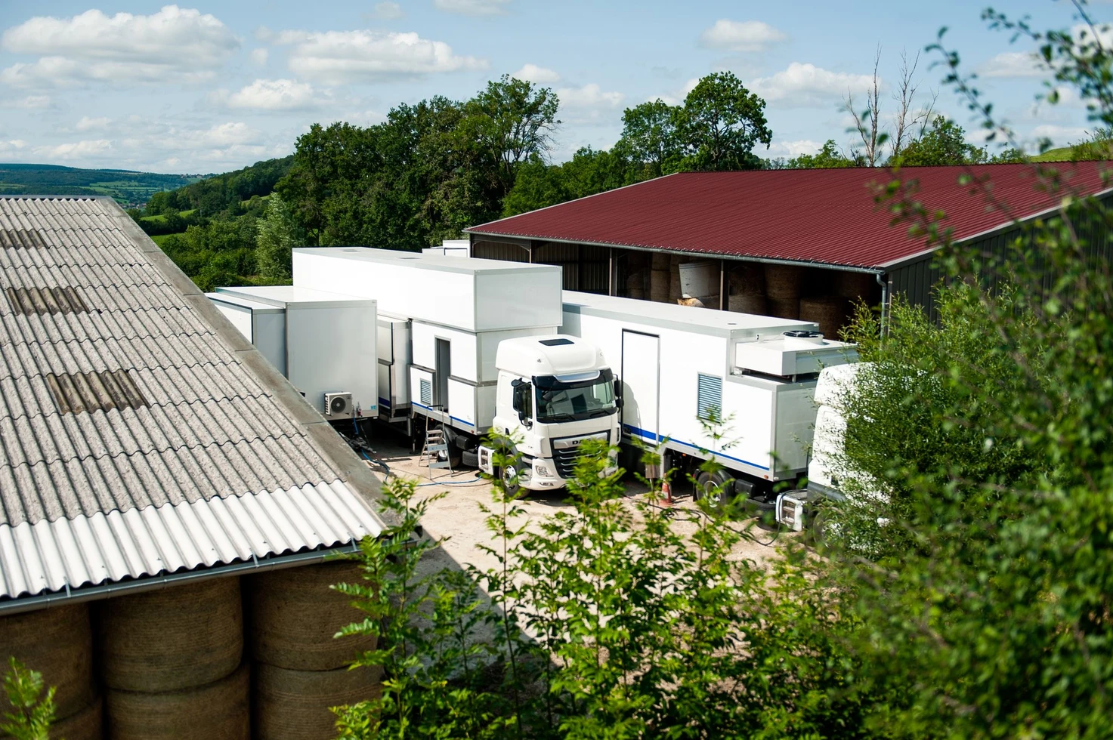
Mobile Applications
Commercial Slaughter of cattle and small stock (sheep, goats & pigs) to compliant meat safety standards. Up to a maximum of 30 Cattle units equivalent per day.
Provide local livestock producers access to slaughter facilities in remote areas where normal commercial slaughter is not possible OR transport costs render the transport of livestock to slaughter unviable.
Provide livestock farmers with a means to market through the sale of meat rather than livestock, attracting a better value return at source as part of a rural meat value chain development.
Provide local communities with an additional food safe source of animal protein, slaughtered under controlled conditions, either in the form of carcasses or offal.
Provide humane and ethical slaughter of animals with traceability of carcasses back to their point of origin.

Slide 4
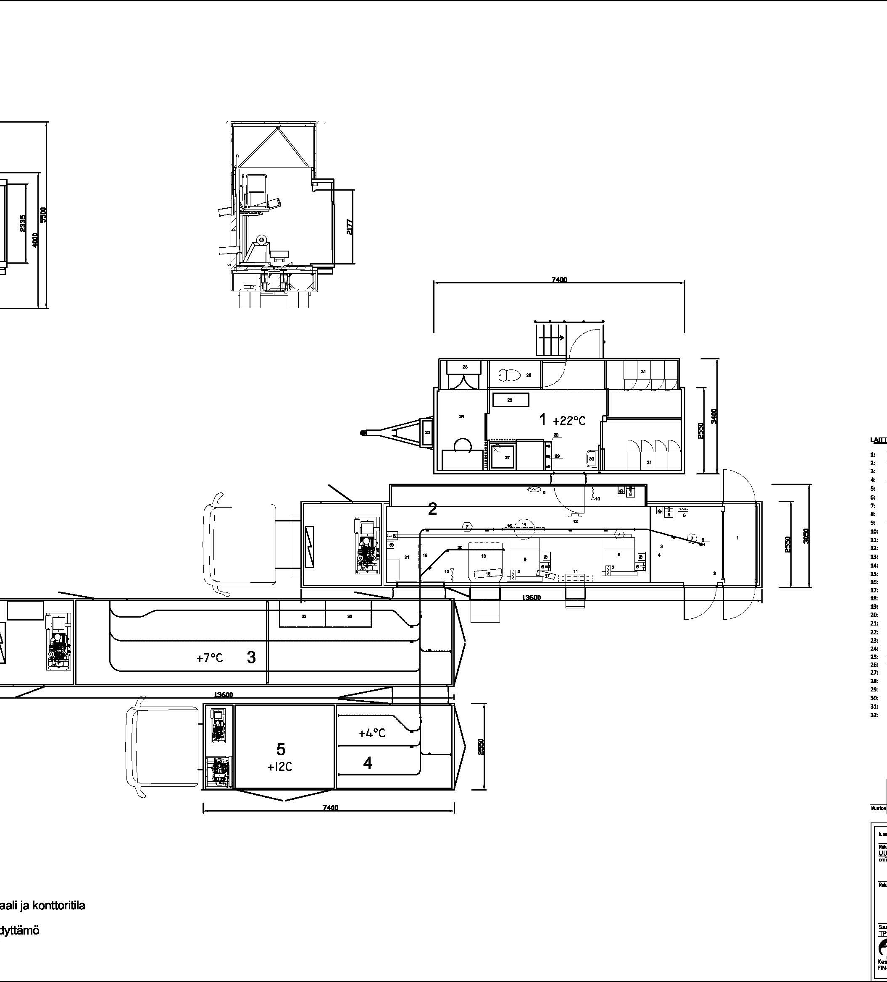
Components
Standard MSU configuration comprises 4 modules
Staff & Veterinary unit
Slaughter and carcass dressing unit
Carcass chilling unit
Hides & offal chilling unit
Other configurations possible based on animal throughput and species.
Onboard facilities for electrical generation, compressed air, potable and waste water tanks, effluent storage.
Operates with a total of 6 staff inclusive of meat inspection or Veterinary personnel.
The slaughter unit uses a Pneumatic lift mechanism to lower stunning box to ground level, to expand the walls & to heighten the ceiling to accommodate full height of cattle carcass.

Slide 5
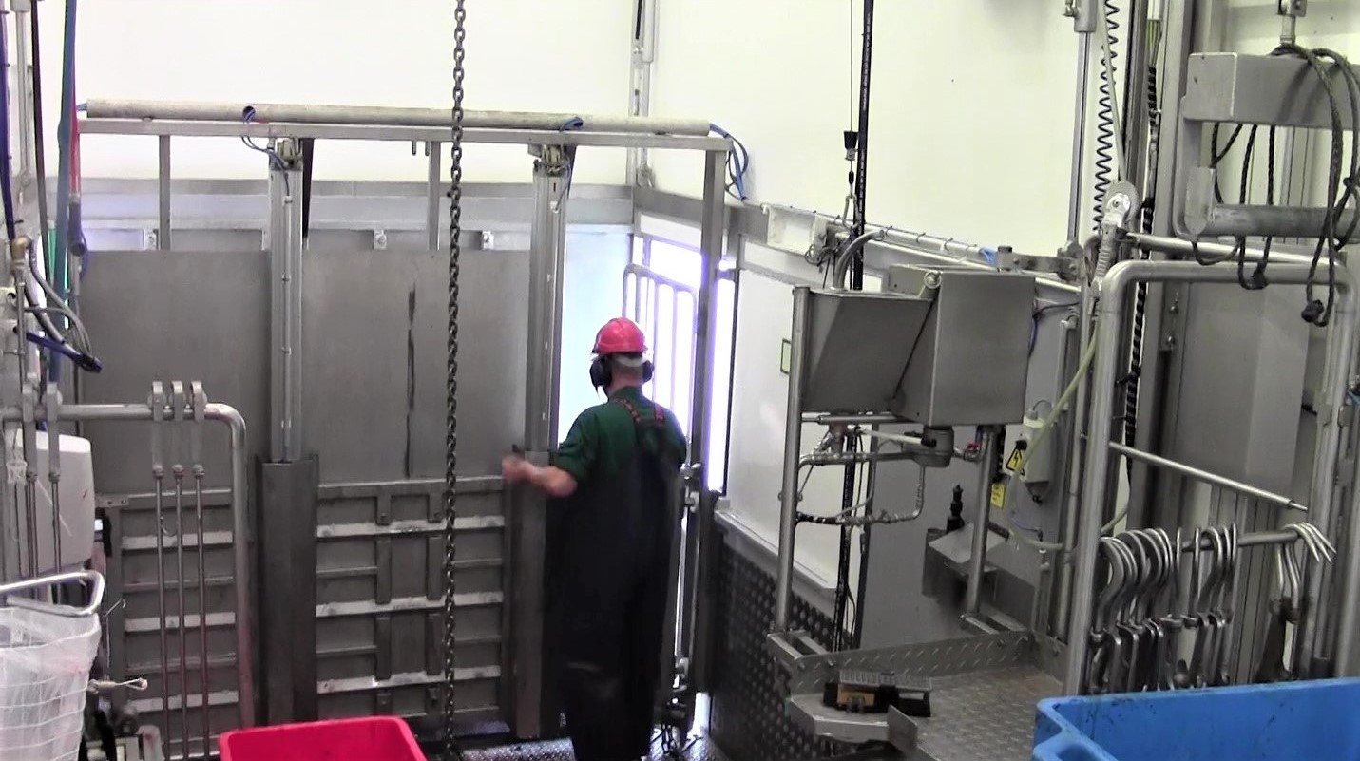
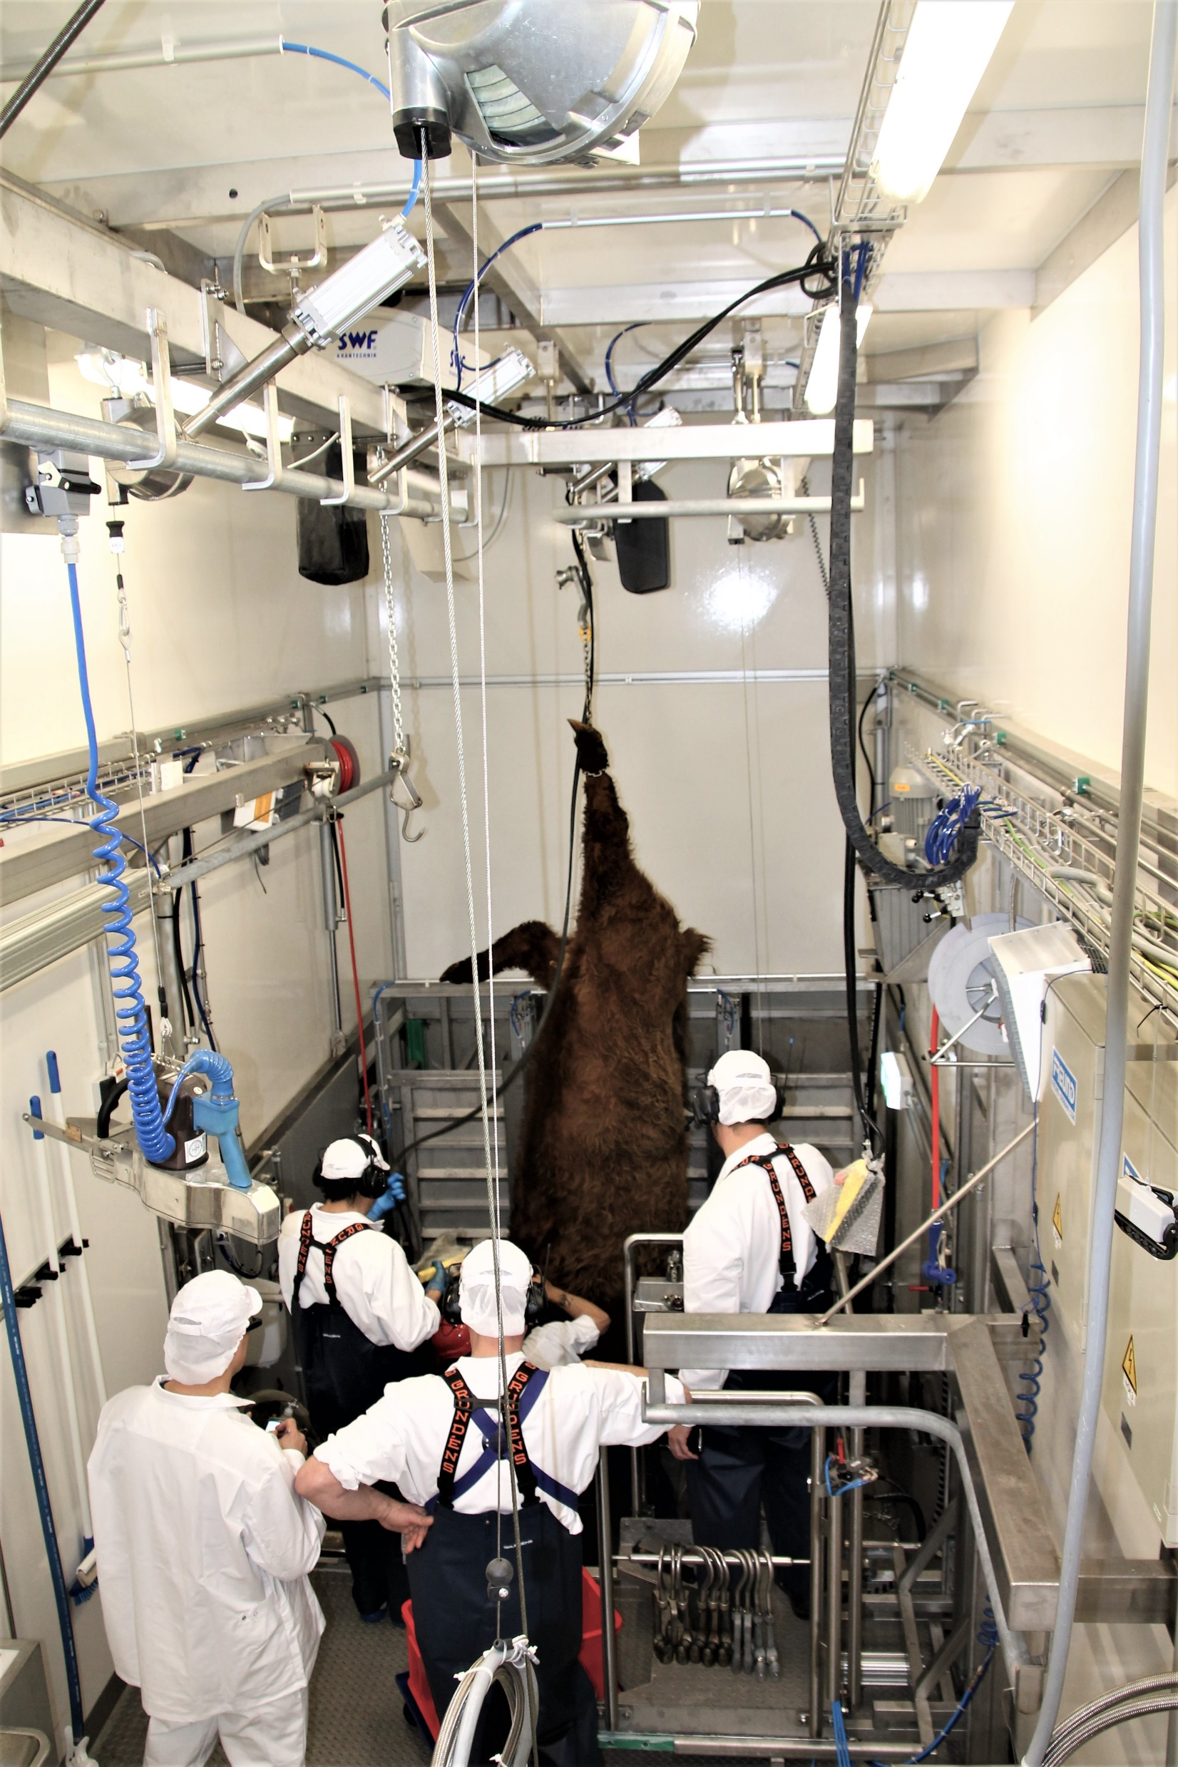
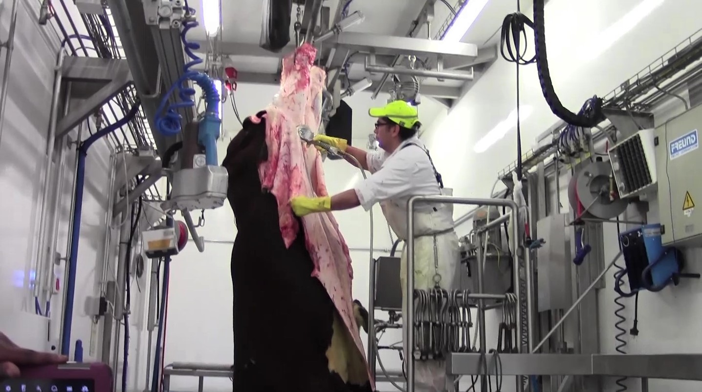
Slaughter line ____________________________________________________________________________________________
Kometos uses only the best components in its mobile slaughterhouses, which are selected together with the customer.

Slide 6
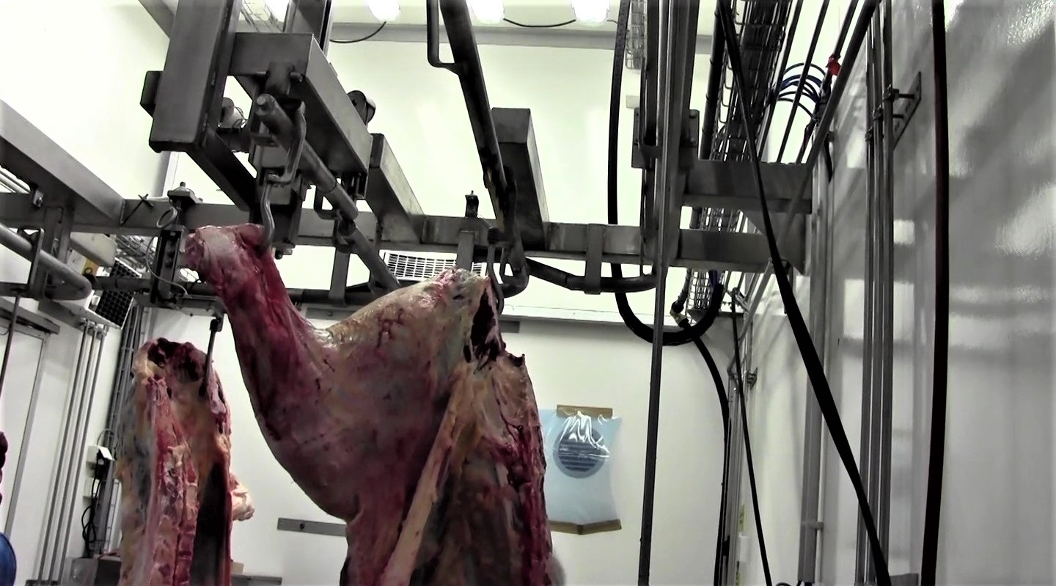
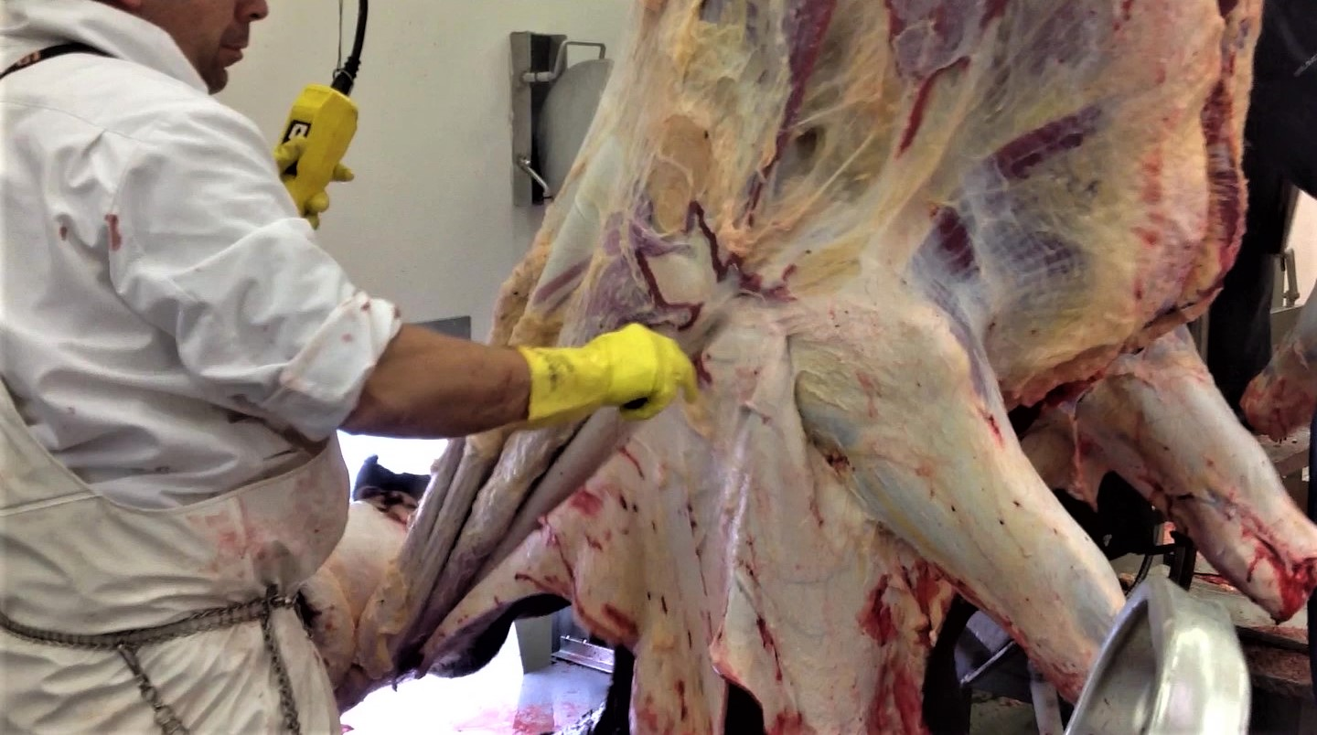
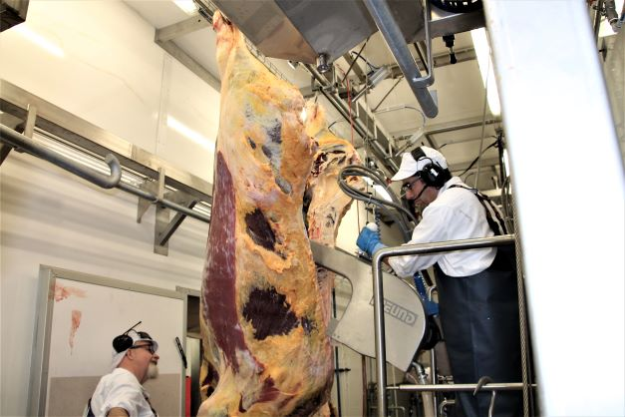
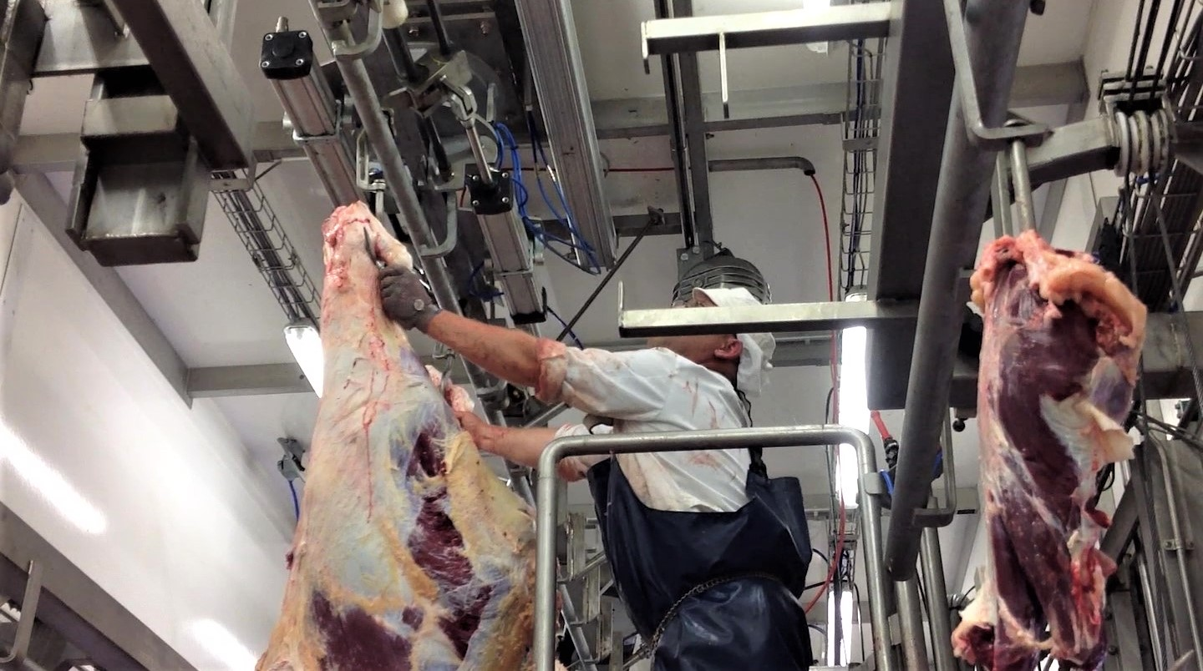
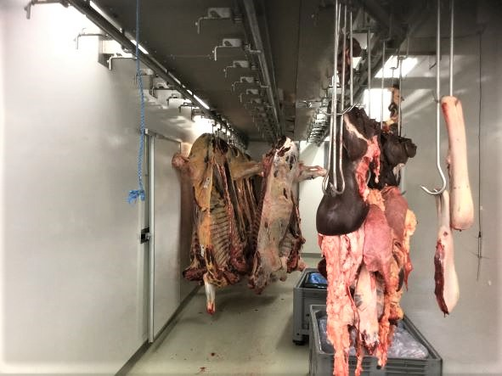

Slide 7
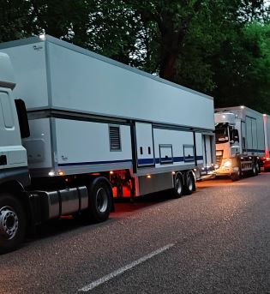
Mobility
Fully mobile with the provision (in the 4 module version) of 3 truck drive units which include:
2 x 2 axle semi trailer
1 x 1 axle trailer
1 x 3 axle truck
Approximately two-hour setup on site is possible
Can either be used in stand-alone operation OR operates in conjunction with prebuilt docking stations providing lairage, carcass chilling and waste facilities.
Can operate as part of a hub and spoke network where chilled carcasses are transported back to a central storage and processing facility for further value addition.

Slide 8

Latest Developments
In August 2021 Kometos’s latest & most technically advanced mobile slaughter unit was delivered to France.
Kometos sets a new benchmark standard for France in terms of ethical handling of animals to slaughter:
Animals not subjected to long transport journeys.
No transiting through aggregation centers and possible mishandling and stress during travel
Animals slaughtered in their natural environment at or close to their place of origin
No breakdown of their social group or mixing with other unknown animals
Animals not subjected to the sounds and smells of large commercial slaughterhouse operations
Slaughter carried out in a humane manner without negligent or handling errors normally prevalent with high throughput facilities.

